Slide 1



Notes:
Welcome. In this presentation, we will explore the execution of models in Provengo and the creation of test suites, also known as ensembles.

Slide 2
const SESSIONS = [
{ name: "s1", customer: Customer(…), products: [Product(…), Product(…)] },
{ name: "s2", customer: Customer(…), products: [Product(…), Product(…)] },
]
SESSIONS.forEach(session => {
bthread("shopping", function () {
with (new SeleniumSession(session.name).start(URL)) {
for (i in session.products)
addToCart(session.products[i]);
checkout()
}
})
bthread("login", function () {
with (new SeleniumSession(session.name).start(URL)) {
login(session.customer)
}
})
bthread("dont-checkout-before-login", function () {
sync({
waitFor: EventSet("", e => e.name == "End(login)" && e.data.session.name == session.name),
block: EventSet("", e => e.name == "Start(checkout)" && e.data.session.name == session.name)
});
})
})
Notes:
Let’s assume we have constructed a model, as depicted here, composed of two sets of b-threads. Each set models a scenario where a customer purchases two items in an individual session. In these scenarios, the login procedure is executed at some point before the checkout step.

Slide 3



const SESSIONS = [
{ name: "s1", customer: Customer(…), products: [Product(…), Product(…)] },
{ name: "s2", customer: Customer(…), products: [Product(…), Product(…)] },
]
SESSIONS.forEach(session => {
bthread("shopping", function () {
with (new SeleniumSession(session.name).start(URL)) {
for (i in session.products)
addToCart(session.products[i]);
checkout()
}
})
bthread("login", function () {
with (new SeleniumSession(session.name).start(URL)) {
login(session.customer)
}
})
bthread("dont-checkout-before-login", function () {
sync({
waitFor: EventSet("", e => e.name == "End(login)" && e.data.session.name == session.name),
block: EventSet("", e => e.name == "Start(checkout)" && e.data.session.name == session.name)
});
})
})
AddToCart
Login
AddToCart
Checkout
Login
AddToCart
AddToCart
Checkout
AddToCart
AddToCart
Login
Checkout
Notes:
Remember, we have already examined the segment within the outer loop and executed it in a single session. This segment simulates three test scenarios, each representing a different login timing: before the first add-to-cart, after the first add-to-cart, or following the second add-to-cart.

Slide 4
const SESSIONS = [
{ name: "s1", customer: Customer(…), products: [Product(…), Product(…)] },
{ name: "s2", customer: Customer(…), products: [Product(…), Product(…)] },
]
SESSIONS.forEach(session => {
bthread("shopping", function () {
with (new SeleniumSession(session.name).start(URL)) {
for (i in session.products)
addToCart(session.products[i]);
checkout()
}
})
bthread("login", function () {
with (new SeleniumSession(session.name).start(URL)) {
login(session.customer)
}
})
bthread("dont-checkout-before-login", function () {
sync({
waitFor: EventSet("", e => e.name == "End(login)" && e.data.session.name == session.name),
block: EventSet("", e => e.name == "Start(checkout)" && e.data.session.name == session.name)
});
})
})
1
6
6
6
9
Notes:
Note, however, that each path of this model consists of 28 steps: one for the start session, six for each add-to-cart, six for the login, and nine for the checkout.

Slide 5
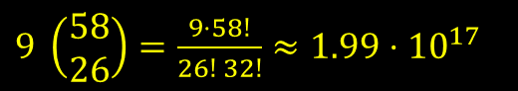

const SESSIONS = [
{ name: "s1", customer: Customer(…), products: [Product(…), Product(…)] },
{ name: "s2", customer: Customer(…), products: [Product(…), Product(…)] },
]
SESSIONS.forEach(session => {
bthread("shopping", function () {
with (new SeleniumSession(session.name).start(URL)) {
for (i in session.products)
addToCart(session.products[i]);
checkout()
}
})
bthread("login", function () {
with (new SeleniumSession(session.name).start(URL)) {
login(session.customer)
}
})
bthread("dont-checkout-before-login", function () {
sync({
waitFor: EventSet("", e => e.name == "End(login)" && e.data.session.name == session.name),
block: EventSet("", e => e.name == "Start(checkout)" && e.data.session.name == session.name)
});
})
})
$$||$$
$9 \left(\begin{matrix}58 \\ 26\end{matrix}\right)=\frac{9⋅58!}{26! 32!}≈\text{1.99}⋅{10}^{17}$
Notes:
Thus, we have many ways to interleave the two sessions together. Specifically, our model contains 199 quadrillion paths!

Slide 6

const SESSIONS = [
{ name: "s1", customer: Customer(…), products: [Product(…), Product(…)] },
{ name: "s2", customer: Customer(…), products: [Product(…), Product(…)] },
]
SESSIONS.forEach(session => {
bthread("shopping", function () {
with (new SeleniumSession(session.name).start(URL)) {
for (i in session.products)
addToCart(session.products[i]);
checkout()
}
})
bthread("login", function () {
with (new SeleniumSession(session.name).start(URL)) {
login(session.customer)
}
})
bthread("dont-checkout-before-login", function () {
sync({
waitFor: EventSet("", e => e.name == "End(login)" && e.data.session.name == session.name),
block: EventSet("", e => e.name == "Start(checkout)" && e.data.session.name == session.name)
});
})
})
$$||$$
$9 \left(\begin{matrix}58 \\ 26\end{matrix}\right)=\frac{9⋅58!}{26! 32!}≈\text{1.99}⋅{10}^{17}$
Notes:
Note that although the shopping processes appear entirely independent from the customers’ viewpoint, it may make sense to examine various interleaved scenarios. This ensures that no concealed system bugs are activated when two users purchase the same product following a specific sequence of interleaved steps.

Slide 7

View a report
Execute
Sample
Model
Notes:
We will show you how to sample the model, run the sampled tests and generate a report to see the test results.

Slide 8
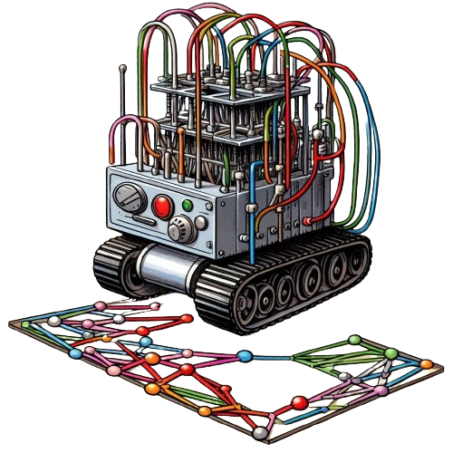
$ provengo sample --size 100 -o random.sample models/shopping
/\
/XX\
{XXXX#####################################
\XX/ / _ \_______ _ _____ ___ ___ ___
\/ / ___/ __/ _ \ |/ / -_) _ \/ _ \/ _ \
/_/ /_/ \___/___/\__/_//_/\_, /\___/
/___/
[SETUP] INFO Input path: models/shopping
[SAMPLER] INFO Sampling 100 random paths
[SAMPLER] INFO Wrote 100 samples to file.
[SAMPLER] INFO Duration: 0 seconds.
[SAMPLER] INFO Sample file: models/shopping/random.sample
Notes:
The sample command in Provengo samples paths from a model and stores it to a file.

Slide 9

$ provengo run -s random.sample models/shopping
/\
/XX\
{XXXX#####################################
\XX/ / _ \_______ _ _____ ___ ___ ___
\/ / ___/ __/ _ \ |/ / -_) _ \/ _ \/ _ \
/_/ /_/ \___/___/\__/_//_/\_, /\___/
/___/
[SETUP] INFO Input path: models/shopping
[RUN ] INFO Preparing to run
[RUN>random.sample] INFO Read 100 tests from models/shopping/random.sample
[RUN>TEST-1] INFO Selected: [StartSession [session=s2 selectors=[http://localhost:8080/login] ]]
…
Notes:
The run command can now be used to execute the sampled paths.

Slide 10

$ provengo report models/shopping
/\
/XX\
{XXXX#####################################
\XX/ / _ \_______ _ _____ ___ ___ ___
\/ / ___/ __/ _ \ |/ / -_) _ \/ _ \/ _ \
/_/ /_/ \___/___/\__/_//_/\_, /\___/
/___/
[SETUP] INFO Input path: models/shopping
[REPORT] INFO Generating report in models/shopping/products/reports
[REPORT] INFO Test Log Report is ready at: models/shopping/products/reports/index.html
[REPORT] INFO Done creating TestLog report
Notes:
The results of the runs are displayed on the console for immediate feedback. Full feedback can be obtained using the “report” command shown here.

Slide 11
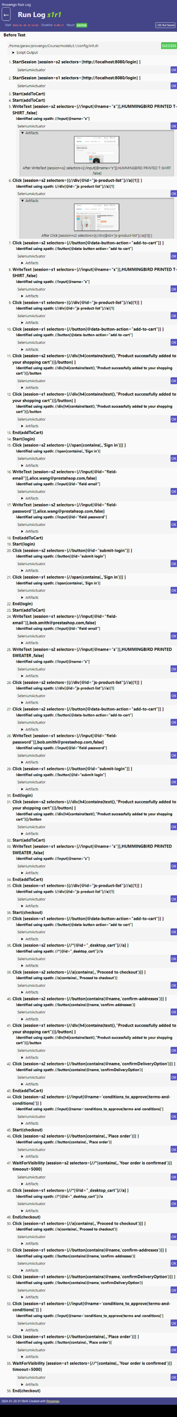
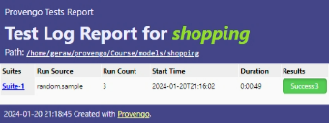
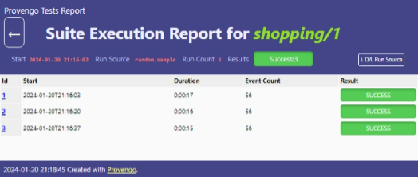
Notes:
The report is provided as an HTML document, compatible with any web browser. It comprehensively details each step in each test in each run, including a snapshot captured when the Selenium action was executed.

Slide 12
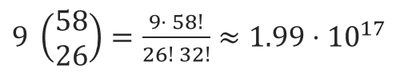
$9 \left(\begin{matrix}58 \\ 26\end{matrix}\right)=\frac{9⋅ 58!}{26! 32!}≈\text{1.99}⋅{10}^{17}$
Notes:
But more than sampling may be needed, considering we are dealing with a model with 199 quadrillion paths!

Slide 13

Login
AddToCart
AddToCart
AddToCart
Checkout
Login
AddToCart
Checkout
AddToCart
AddToCart
Login
Checkout
Notes:
In our model, for instance, we aim to design our test suite to encompass the three potential positions of the ‘login’ feature, with each position being represented equally.

Slide 14
Execute & report
Ensemble
Sample
Model
Notes:
We will show how this is possible with Provengo’s ranking functions and ensemble creation features.

Slide 15
bthread("Mark login at", function () {
const endOfActionES = EventSet("", e => e.name.startsWith("End(")
&& e.data.session.name == session.name);
let e = sync({ waitFor: endOfActionES })
for (var count = 0; e.name != "End(login)"; count++)
e = sync({ waitFor: endOfActionES })
sync({ request: Ctrl.markEvent(`LoginAt${count}`) })
})
Notes:
We will first demonstrate the use of marker events. These are specialized events that don’t trigger any actions within the system being tested but serve to annotate specific points during a run. In this code, we have incorporated a b-thread that is tasked with counting the number of ‘End’ events preceding the conclusion of the login action. The total count is then broadcasted through a marker event named “LoginAt”.

Slide 16
const GOALS = [
Ctrl.markEvent("LoginAt0"),
Ctrl.markEvent("LoginAt1"),
Ctrl.markEvent("LoginAt2"),
];
…/meta-spec/ensemble-code.js
Notes:
The Provengo tool facilitates the specification of target outcomes that our tests are designed to accomplish. In this context, our objective is to reach all potential waypoints.

Slide 17
const GOALS = [
Ctrl.markEvent("LoginAt0"),
Ctrl.markEvent("LoginAt1"),
Ctrl.markEvent("LoginAt2"),
];
…/meta-spec/ensemble-code.js
$ provengo sample models/shopping
/\
/XX\
{XXXX#####################################
\XX/ / _ \_______ _ _____ ___ ___ ___
\/ / ___/ __/ _ \ |/ / -_) _ \/ _ \/ _ \
/_/ /_/ \___/___/\__/_//_/\_, /\___/
/___/
[SETUP] INFO Input path: models/shopping
[SAMPLER] INFO Sampling 1500 random paths
[SAMPLER] INFO Wrote 1,500 samples to file.
[SAMPLER] INFO Duration: 27 seconds.
[SAMPLER] INFO Sample file: models/shopping/products/run-source/samples.json
$ provengo ensemble models/shopping
/\
/XX\
{XXXX#####################################
\XX/ / _ \_______ _ _____ ___ ___ ___
\/ / ___/ __/ _ \ |/ / -_) _ \/ _ \/ _ \
/_/ /_/ \___/___/\__/_//_/\_, /\___/
/___/
[SETUP] INFO Input path: models/shopping
[ENSEMBLER] INFO Reading samples file models/shopping/products/run-source/samples.json.
[ENSEMBLER] INFO Read 1,500 samples.
[ENSEMBLER] INFO Ensemble created (duration 10 seconds).
[ENSEMBLER] INFO GeneticOptimizer generated an ensemble of size 30 with rank 100.000.
[ENSEMBLER] INFO Writing the generated ensemble to models/shopping/products/run-source/ensemble.json
Notes:
We can then sample the model and use the sample to create a test suite that maximizes the percentage of achieved goals.

Slide 18
const GOALS = [
Ctrl.markEvent("LoginAt0"),
Ctrl.markEvent("LoginAt1"),
Ctrl.markEvent("LoginAt2"),
];
…/meta-spec/ensemble-code.js
$ provengo sample models/shopping
/\
/XX\
{XXXX#####################################
\XX/ / _ \_______ _ _____ ___ ___ ___
\/ / ___/ __/ _ \ |/ / -_) _ \/ _ \/ _ \
/_/ /_/ \___/___/\__/_//_/\_, /\___/
/___/
[SETUP] INFO Input path: models/shopping
[SAMPLER] INFO Sampling 1500 random paths
[SAMPLER] INFO Wrote 1,500 samples to file.
[SAMPLER] INFO Duration: 27 seconds.
[SAMPLER] INFO Sample file: models/shopping/products/run-source/samples.json
$ provengo ensemble models/shopping
/\
/XX\
{XXXX#####################################
\XX/ / _ \_______ _ _____ ___ ___ ___
\/ / ___/ __/ _ \ |/ / -_) _ \/ _ \/ _ \
/_/ /_/ \___/___/\__/_//_/\_, /\___/
/___/
[SETUP] INFO Input path: models/shopping
[ENSEMBLER] INFO Reading samples file models/shopping/products/run-source/samples.json.
[ENSEMBLER] INFO Read 1,500 samples.
[ENSEMBLER] INFO Ensemble created (duration 10 seconds).
[ENSEMBLER] INFO GeneticOptimizer generated an ensemble of size 30 with rank 100.000.
[ENSEMBLER] INFO Writing the generated ensemble to models/shopping/products/run-source/ensemble.json
Notes:
In this case, the tool generated a suite of tests, called an ensemble, that achieved 100% coverage for the specified goals.

Slide 19

let pairs = [[0, 0], [0, 1], [0, 2], [1, 0], [1, 1], [1, 2], [2, 0], [2, 1], [2, 2]]
pairs.forEach(([i, j]) => {
bthread(`Mark login comb (${i}, ${j})`, function () {
sync({ waitFor: Ctrl.markEvent(`LoginAt${i}`) });
sync({ waitFor: Ctrl.markEvent(`LoginAt${j}`) });
[i, j] = [i, j].sort()
sync({ request: Ctrl.markEvent(`LoginComb(${i}, ${j})`) })
})
})
const GOALS = [
Ctrl.markEvent("LoginAt0"),
Ctrl.markEvent("LoginAt1"),
Ctrl.markEvent("LoginAt2"),
Ctrl.markEvent("LoginComb(0, 0)"),
Ctrl.markEvent("LoginComb(0, 1)"),
Ctrl.markEvent("LoginComb(0, 2)"),
Ctrl.markEvent("LoginComb(1, 1)"),
Ctrl.markEvent("LoginComb(1, 2)"),
Ctrl.markEvent("LoginComb(2, 2)"),
];
…/meta-spec/ensemble-code.js
Notes:
We can delve deeper: Our example involves two sessions, and we might aim to cover all permutations of the login locations across both sessions. The upper code segment displays the b-thread that marks the combination, while the segment beneath it exhibits the refreshed GOALS list.

Slide 20
$ provengo sample models/shopping
/\
/XX\
{XXXX#####################################
\XX/ / _ \_______ _ _____ ___ ___ ___
\/ / ___/ __/ _ \ |/ / -_) _ \/ _ \/ _ \
/_/ /_/ \___/___/\__/_//_/\_, /\___/
/___/
[SETUP] INFO Input path: models/shopping
[SAMPLER] INFO Sampling 1500 random paths
[SAMPLER] INFO Wrote 1,500 samples to file.
[SAMPLER] INFO Duration: 27 seconds.
[SAMPLER] INFO Sample file: models/shopping/products/run-source/samples.json
$ provengo ensemble models/shopping
/\
/XX\
{XXXX#####################################
\XX/ / _ \_______ _ _____ ___ ___ ___
\/ / ___/ __/ _ \ |/ / -_) _ \/ _ \/ _ \
/_/ /_/ \___/___/\__/_//_/\_, /\___/
/___/
[SETUP] INFO Input path: models/shopping
[ENSEMBLER] INFO Reading samples file models/shopping/products/run-source/samples.json.
[ENSEMBLER] INFO Read 1,500 samples.
[ENSEMBLER] INFO Ensemble created (duration 10 seconds).
[ENSEMBLER] INFO GeneticOptimizer generated an ensemble of size 30 with rank 100.000.
[ENSEMBLER] INFO Writing the generated ensemble to models/shopping/products/run-source/ensemble.json
Notes:
We can, again, sample the model and use the sample to create a test suite that maximizes the percentage of achieved goals.

Slide 21
Notes:
This concludes our presentation. We’ve explored how Provengo models can be sampled and how the ensemble tool facilitates the generation of test suites that are tailored to satisfy coverage requirements.

